Slide 1
Intro to Python

Slide 2
Why python for image processing?

Slide 3
Let’s get started….Hello world ☺

Slide 4
Does python have a compiler? Or interpreter? Or both

Slide 5
If you need help…. Call help…. Not me.

Slide 6
What is a variable?

Slide 7
Data types in Python
Numbers
Booleans
String
List
Tuple
Dictionary

Slide 8
So how will you check what is in a box?

Slide 9
How will you check what type of box is that?

Slide 10
What is a list?

Slide 11
What is a tuple?

Slide 12
If you are clever you must ask me the difference….

Slide 13
1.Tuples and lists are two similar sequences of the same programming language, Python. Tuples are immutable which means they cannot be modified once they are created; whereas, a list is a sequence which is mutable. It can be modified after it is created, and it supports additional operations too. 2.The literal syntax of tuples is shown by parentheses whereas the literal syntax of lists is shown by square brackets. 3.Tuples are heterogeneous while lists are homogeneous. One has to deal individually with the items. 4.Tuples show structure whereas lists show order.

Slide 14
Let me confuse you more ……

Slide 15
There is also a dictionary (:o

Slide 16
Can a dictionary can be changed or not?

Slide 17
Sorry …but….there are also arrays….. ☹

Slide 18
Operators
• Arithmetic Operators
• Comparison (Relational) Operators
• Assignment Operators
• Logical Operators
• Membership Operators
• Identity Operators

Slide 19
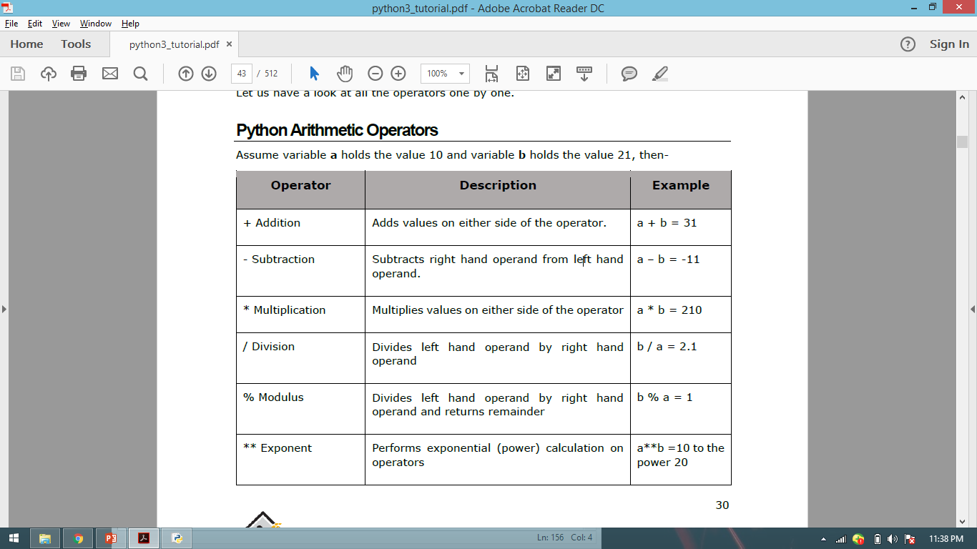
// Floor Division - The division of operands where the result is the quotient in which the digits
after the decimal point are removed.

Slide 20
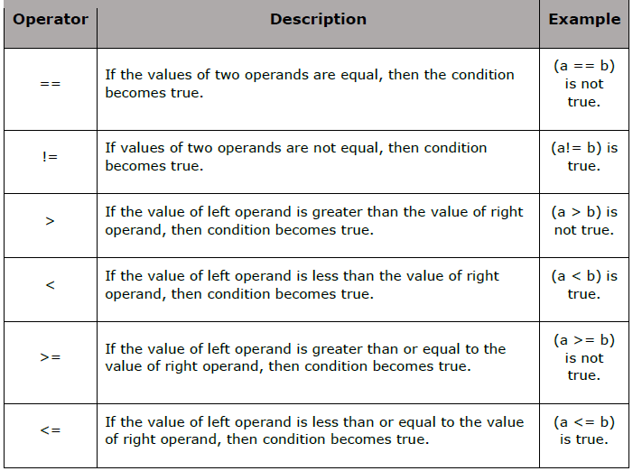

Slide 21
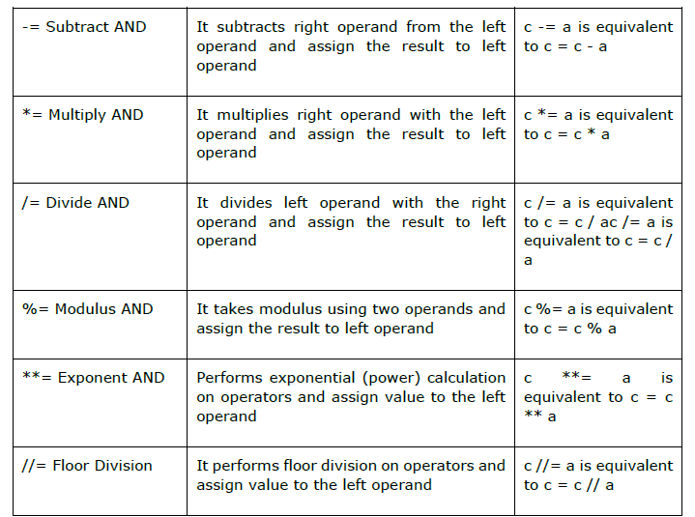

Slide 22
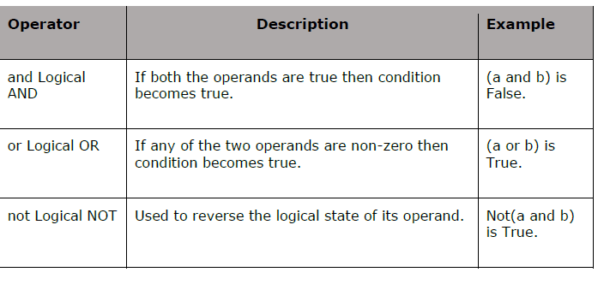

Slide 23
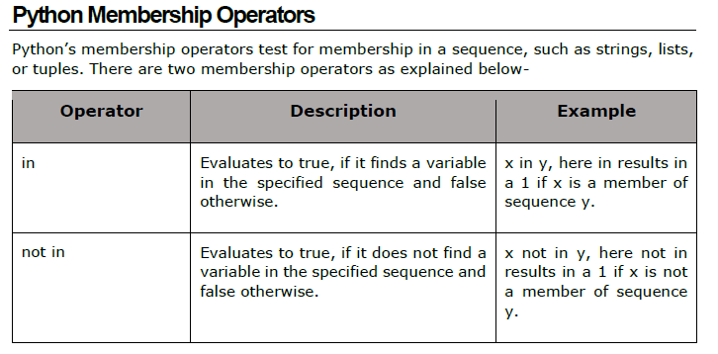

Slide 24
Let’s get something from the user….

Slide 25
Decision making…..
if
if …. else….
if …..elif…….else

Slide 26
Let’s start doing it again and again and again………….

Slide 27
Functions()

Slide 28
Let’s get matlab into python……………

Slide 29
The Numpy library……

Slide 30
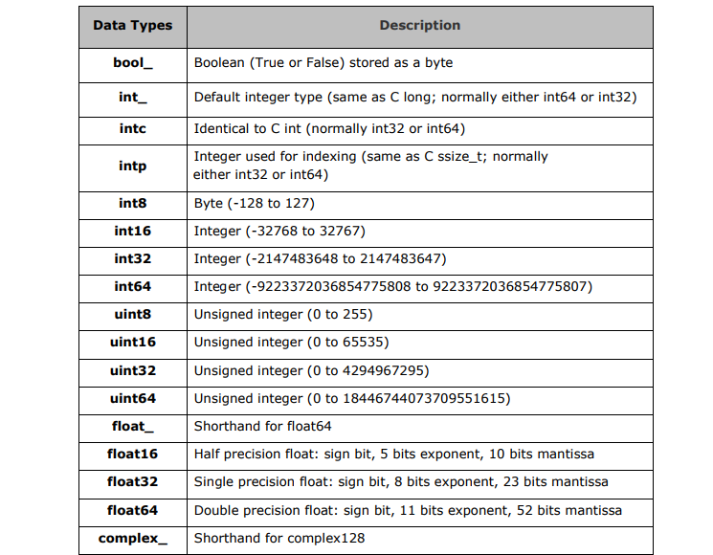

Slide 31
Lets plot lines…….

Slide 32
Let’s plot some matrix……

Slide 33
Let’s read an image….display it …..and its statistics………..

